Slide 1

Lesson 10: IO, NIO

Slide 2
Lesson plan:
IO
Streams
NIO
Selectors
Resource management
Serialization
Q&A

Slide 3
What is Input\Output?
“Java IO basically provides a mechanism to read data from a source and write data to a destination”
@Someone

Slide 4
Blocking IO
Blocking IO wait for the data to be write or read before returning. Java IO’s various streams are blocking. It means when the thread invoke a write() or read(), then the thread is blocked until there is some data available for read, or the data is fully written.

Slide 5
Data stream
Stream - a continuous flow of data (bytes, chars, objects)

Slide 6
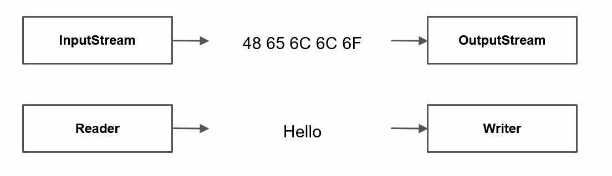
Stream types
By direction Input Output | By content Bytes Characters

Slide 7
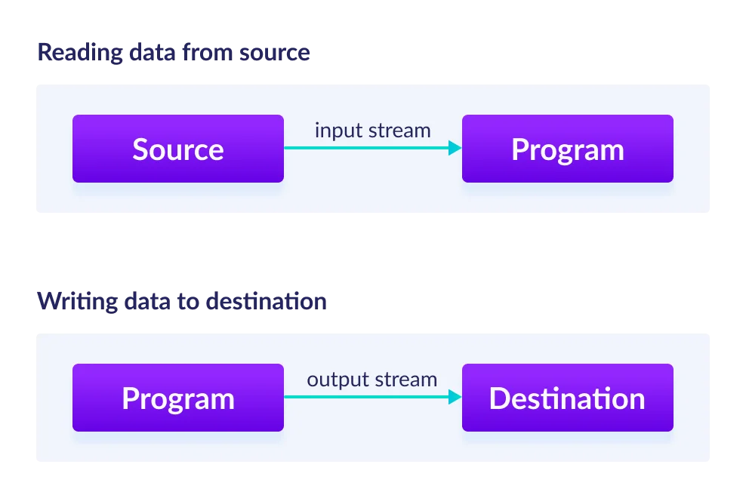
Stream types
Reading data from source
Writing data to destination

Slide 8
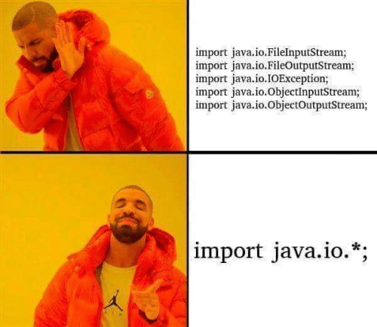
Stream types

Slide 9
Stream types
Name | Level | Description
FileInputStream | Low | Reads file data as bytes
FileOutputStream | Low | Writes file data as bytes
FileReader | Low | Reads file data as characters
FileWriter | Low | Writes file data as characters
BufferedReader | High | Reads character data from an existing Reader in a buffered manner
BufferedWriter | High | Writes character data to an existing Writer in a buffered manner
ObjectInputStream | High | Deserializes primitive Java data types and graphs of Java objects from an existing InputStream
ObjectOutputStream | High | Serializes primitive Java data types and graphs of Java objects to an existing OutputStream
InputStreamReader | High | Reads character data from an existing InputStream
OutputStreamWriter | High | Writes character data to an existing OutputStream
PrintStream | High | Writes formatted representations of Java objects to a binary stream
PrintWriter | High | Writes formatted representations of Java objects to a text-based output stream

Slide 10
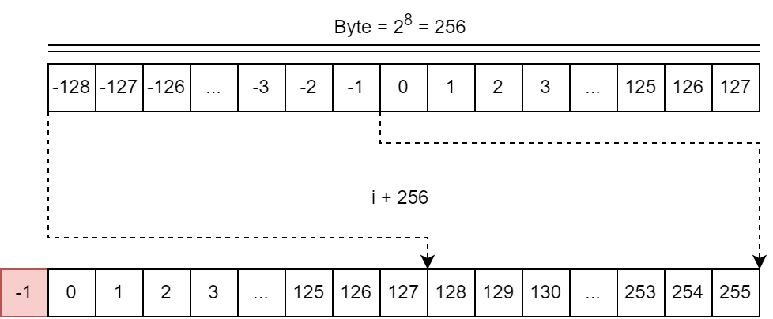
InputStream
int read() / read(…)
void close()
boolean markSupported()
void mark(readLimit) / reset()
long skip(n)
int available()

Slide 11
OutputStream
write(byte bytes[]) / write(…)
flush()
close()

Slide 12
IO on practice

Slide 13
Questions & Answers
“Asking questions is a good way to learn more”
@Vasya Rudas

Slide 14
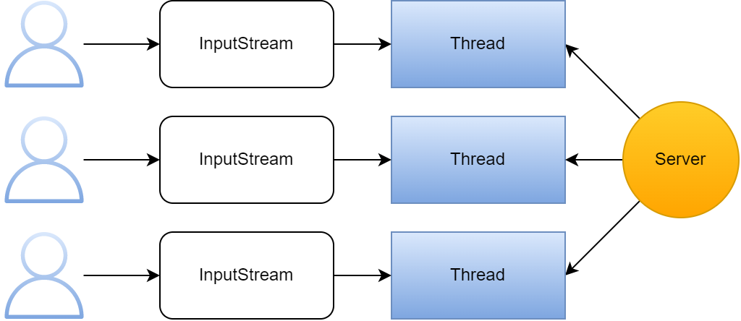
IO issues

Slide 15
IO Evolution
1996
2002
2011
2022
IO
NIO
NIO2

Slide 16
Non-blocking IO
Non blocking IO does not wait for the data to be read or write before returning. Java NIO non- blocking mode allows the thread to request writing data to a channel, but not wait for it to be fully written. The thread is allowed to go on and do something else in a mean time.

Slide 17
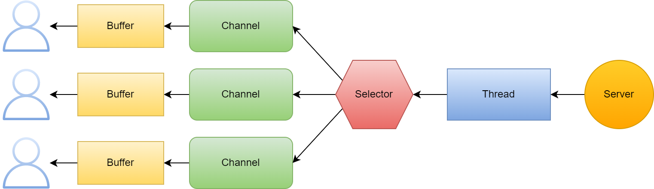
Non-blocking IO

Slide 18
NIO on practice

Slide 19
IO vs NIO
IO | NIO
Java IO is Stream oriented | Java NIO is Buffer oriented
Blocking IO operation | Non-blocking IO operation
Channels are not available | Channels are available

Slide 20
Questions & Answers
“Asking questions is a good way to learn more”
@Vasya Rudas

Slide 21

Resource management

Slide 22
Closeable
import java.io.Closeable;
import java.io.IOException;
public class Example implements Closeable {
@Override
public void close() throws IOException {
}
}
The interface Closeable provides a method called close() which handles closing a source or a destination of data. Every implementation of OutputStream must provide an implementation of this method. Here they can perform actions to release resources.

Slide 23
Resource closure
public static void main(String[] args) {
try {
loadFile("path/to/file");
} catch (FileNotFoundException e) {
System.out.println("Cannot load file!");
} finally {
System.out.println("File load finished!");
}
}
The "try" keyword is used to specify a block where we should place an exception code. It means we can't use try block alone. The try block must be followed by either catch or finally.
The "catch" block is used to handle the exception. It must be preceded by try block which means we can't use catch block alone. It can be followed by finally block later.
The "finally" block is used to execute the necessary code of the program. It is executed whether an exception is handled or not.

Slide 24
Close resource via finally block
public void print(String msg) {
FileOutputStream writer = null;
try {
writer = new FileOutputStream(LOG_FILE.toString(), true);
writer.write(msg.getBytes());
writer.write("\n".getBytes());
} catch (IOException e) {
e.printStackTrace();
} finally {
close(writer);
}
}
void close(Closeable resource) {
if(nonNull(resource)) {
try {
resource.close();
} catch (IOException e) {
System.out.println("Failed to close resource");
}
}
}

Slide 25
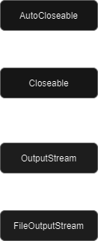
AutoCloseable
import java.io.IOException;
public class Example implements AutoCloseable {
@Override
public void close() throws IOException {
}
}
The interface AutoCloseable also provides a method called close() with similar behavior to the one in Closeable. In this case, however, the method close() is automatically called when exiting a try-with-resource block.

Slide 26
Try-with-resources
public void print(String msg) {
try (FileOutputStream writer = new FileOutputStream(LOG_FILE.toString(), true)) {
writer.write(msg.getBytes());
writer.write("\n".getBytes());
} catch (IOException e) {
e.printStackTrace();
}
}

Slide 27
Questions & Answers
“Asking questions is a good way to learn more”
@Vasya Rudas

Slide 28
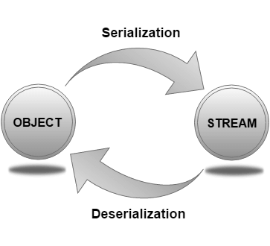
Data serialization\deserialization
import java.io.Serial;
import java.io.Serializable;
public class Example implements Serializable {
@Serial
private static final long serialVersionUID = 1L;
}
Serialization is the conversion of the state of an object into a byte stream; deserialization does the opposite.
Serialization
Deserialization

Slide 29
Serializable on practice

Slide 30

Homework
Create application that can download music from the Internet and store it in a special path:
‘<user_home>/Music Library/<genre>/<group>/<album>/<song_name>.mp3’
Details:
You have a file which contains all information about the song. It’s genre, album, name and link where it can be downloaded.
At the start of the program your program should read this file and download all songs that currently not exist in the Music Library.

Slide 31
Homework
Cover logic with validations:
File size cannot be more than 10mb
Link to the file must be valid
File genre, album, group and name must be valid
All validations errors must be logged and handled
Program logger should write logs to the console and file.
Log types: Error, Info
Log file should be in the resources folder
Log should contain date in dd/mm/yyyy HH:mm:ss
Program should have an ability to:
show all logs in the console when user selects specific option
select only error/info/all logs
change ordering by date\type for logs
Cover all logic with unit tests

Slide 32

Questions & Answers

Slide 33
Literature
Java error model:
lO/NIO - Oracle
Java - Files and I/O
Java - Files and IO/NIO Habr

Slide 34
Thanks!
Find us in Slack:
@Bohdan Cherniak
@Vladyslav Nikolenko
@Volodymyr Vedula

